Slide 2
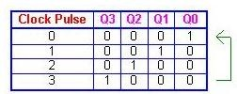
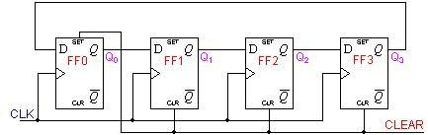





Ring Counter
Output of the last flip flop is connected as an input to the first flip-flop is known as a Ring counter.
Ring counter divides the frequency of the clock signal by ‘n’.

Slide 3
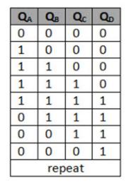
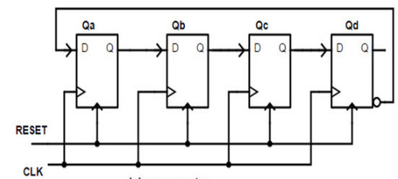
Johnson or Twisting Ring Counter
Modification of ring counter.
If we use n flip-flops to design the Johnson counter,
it is known as 2n bit Johnson counter or Mod 2n Johnson counter.

Slide 4
MCQ
In a 4-bit Johnson counter sequence, there are a total of how many states or bit patterns?
a) 1 b) 3 c) 4 d) 8

